Slide 1
Accessing the curriculum for diverse learners
Adapting Texts

Slide 2

I Put On My Clothes
By Cindy Nankee

Slide 3
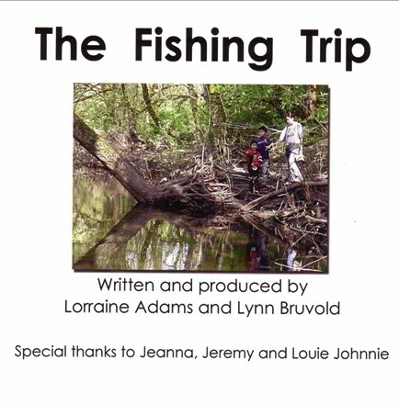
Accessible Books
Accessible Books are children’s picture books in accessible formats.
Books are scanned and images added to accessible software.
Text is recorded using digitized (human reader) or synthesized (computer speech) speech.
The graphics, text and narration are then available for reading on computer or touch devices.
The student uses assistive technology to access the books.

Slide 4
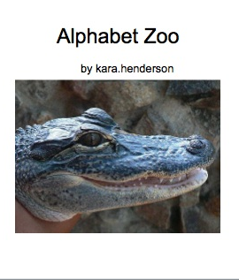
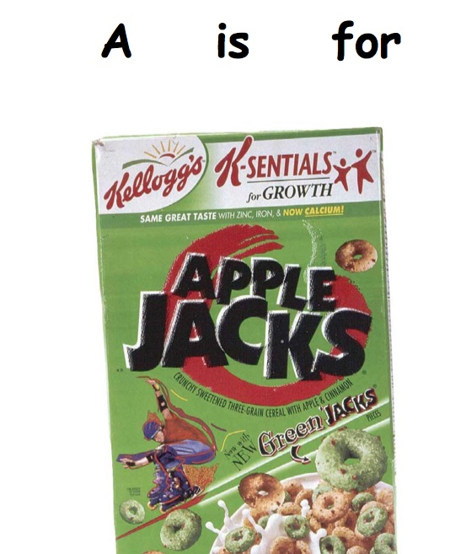
Customized Books

Slide 5
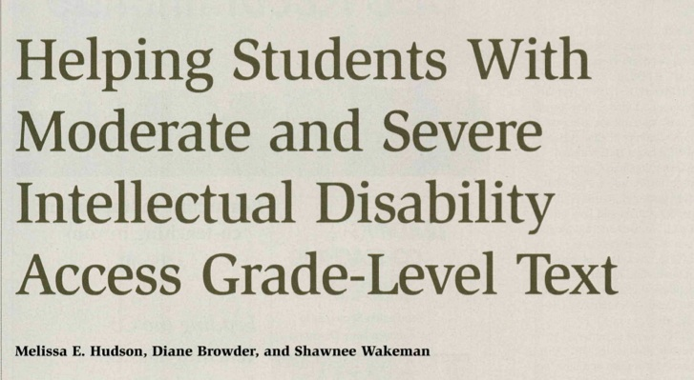
Discussion

Slide 6
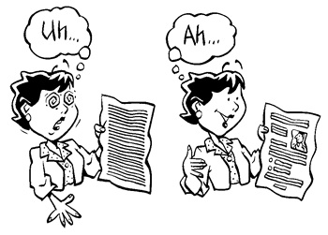
Activity: Creating clear text
Rewrite the assigned text from one of the chapter books or novels typically used in regular classrooms
Consider language, formatting, use of visuals, etc.
Discuss challenges and how you can address them

Slide 7
Components of reading comprehension
Conceptual Knowledge
Language Skills
Text Features
Strategies
Fluent Decoding

Slide 8
Different Levels of Reading Comprehension
Literal
Getting the facts
Locating the answer
Following directions
Detecting a sequence
Inferential
Identifying the main idea
Drawing conclusions
Using the context
Interpretive / critical
Analysis of characterization, plot, theme, style

Slide 9
How to support reading comprehension
Planning Decisions
Select the correct level of text
Adapt and / or modify the text
Text Supports
Use visuals and story props
Use book specific topic boards
Use graphic organizers
Reading software
Video accompanying the text
Use picture / symbol enhanced test
Instructional Frameworks
Use before, during and after framework when reading with students
Build background knowledge
Set a clear purpose for reading
Monitor comprehension
Apply learning
Locating answers to questions using the system of least prompts
Use graphic organizers

Slide 10
Help the student find the answer
Cue / Prompt | Response
Instructional Cue | Ask the question and wait for the student to answer
Prompt 1 | Reread a portion of the text that contains the answer
Prompt 2 | Reread the sentence with the answer
Prompt 3: Model | Reread the sentence and point to / say the correct answer
Prompt 4 | Guide student to touch correct answer

Slide 11
Rules for answering comprehension questions
When you hear | (Insert Boardmaker symbols to each line)
Why | Listen for a because
Who | Listen for a name
When | Listen for a time or date
Where | Listen for place
What | Listen for a thing

Slide 12
Teaching WH definitions
Question Word | Definition | Examples
who | people
where | places
what | things
when | time
how | ways
why | reasons

Slide 13
Graphic Organizer
Title
When
What
Where
Who
Why
How

Slide 14
Focus reading
Title of Book and Chapter
Page number | Wh question
Page number | Wh question
Page number | Wh question
Page number | Wh question
Page number | Wh question
Page number | Wh question

Slide 15
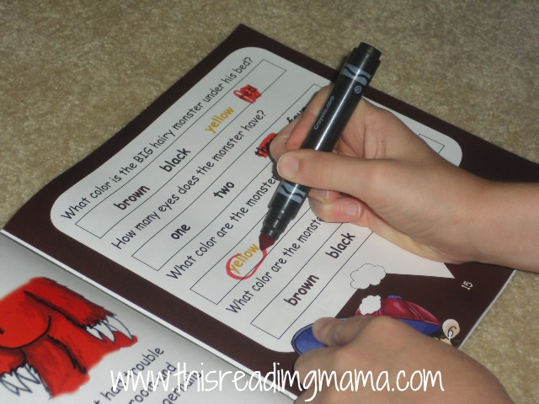
Formats for Checking Comprehension
Matching
Choice making
Cloze
Questions
Retelling

Slide 16
What is Writing
Writing is
Writing is not
Getting thoughts on paper
A cognitive act, not a motor act
Copying
Handwriting – a motor activity
Tracing – fine motor task

Slide 17
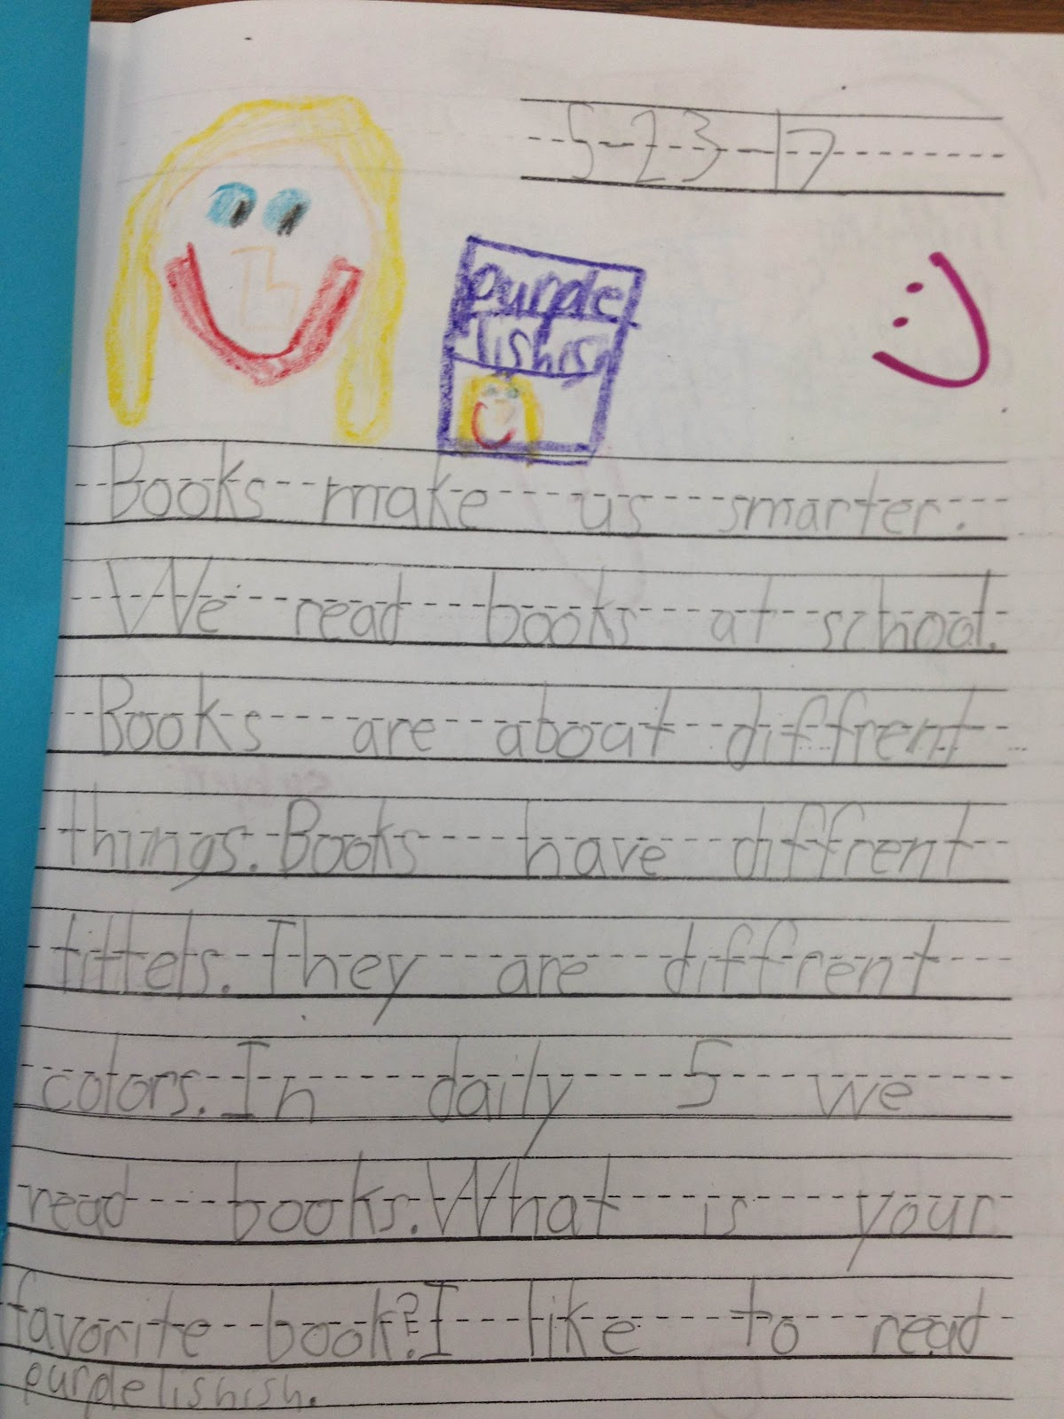
Challenges for students with disabilities
Can’t hold a standard pen, pencil, crayon or marker
Can’t talk about their efforts
Can’t see other providing models of writing

Slide 18
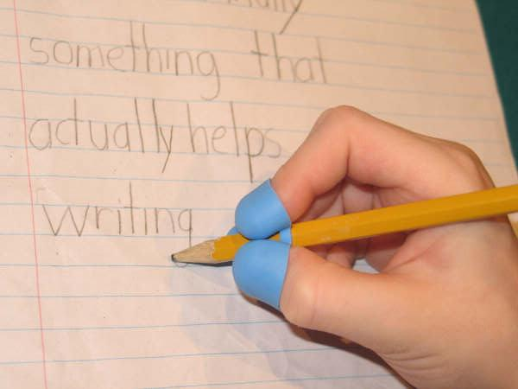
Solutions to the challenges
Can’t hold a standard pen, pencil, crayon or marker – try…
Can’t talk about their efforts – try …
Can’t see other providing models of writing – try …

Slide 19

Literacy Development

